Slide 1



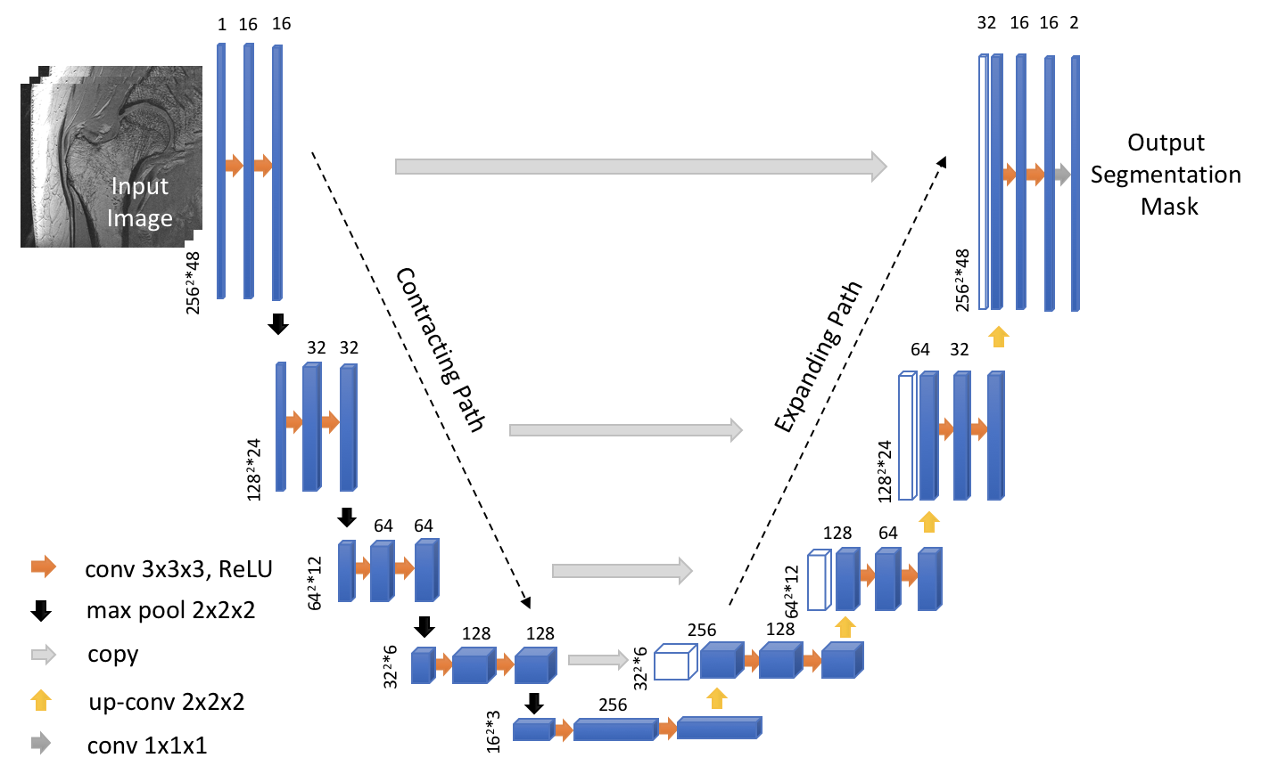
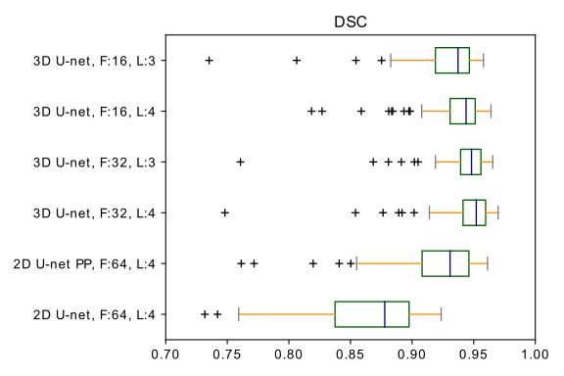
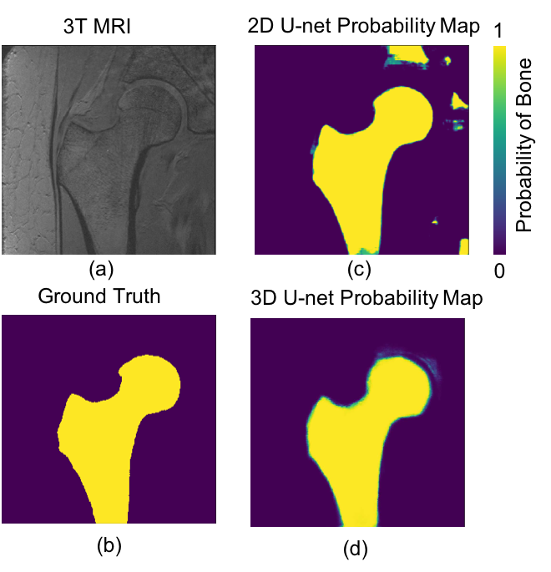
3D Convolutional Networks for proximal Femur Segmentation in mr images
Presenter: Cem M. Deniz
Siyuan Xiang, Gregory Chang, Stephen Honig, Kyunghyun Cho, and Cem M. Deniz
Introduction
Methods
The segmentation in MR images of trabecular bone has been widely used for measuring bone quality and assessing fracture risk precisely. Manual segmentation is time-intensive, limiting the use of MRI measurements in clinical practice. To overcome this bottleneck, several deep convolutional neural network (CNN) architectures¹⁻⁴ have been successfully used in medical research for image segmentation. Recently, CNNs based on 2D convolutions for proximal femur segmentation have been proposed^{5,6}. In this work, we investigated the extension of 3D U-net architecture⁷ with padded convolutions and max-pooling layers for automatic proximal femur segmentation. We found that the proposed method provides accurate segmentation without any post-processing, bringing trabecular bone analysis closer to clinical practice.
Figure A
We used a supervised deep CNN for automatic fracture risk assessment based on the 3D U-net architecture. Convolutional kernel weights were initialized by Xavier and He initialization^{8,9}. For non-linearly transforming the data during modeling, rectifier linear units (ReLU)¹⁰ were used. Since the background constitutes a large portion of the images, we used weighted cross entropy to balance contributes from different classes, where the weights are computed from the ground truth of training data. To evaluate the generalization ability of models, we performed 4-fold cross validation.
Results
Results
ROC and precision-recall curve analysis of 2D and 3D models on the validation set show a high accuracy of the best 3D U-net, using 4 layers and 32 features, with area under the ROC curve (AUC) =0.9980±0.0013 and average precision from precision-recall curve (AP) =0.9821±0.0048. This significantly exceeds those of the 2D U-net which achieved AUC =0.9921±0.0005 and AP =0.9278±0.0118. The 3D U-net also reached the highest dice similarity coefficient (DSC) score (0.9395±0.0536) among these models.
Individual DSC scores obtained from validation subjects are illustrated in Figure B. Segmentation results for different network architectures on a sample subject are presented in Figure C.
Figure B
Figure C
Conclusions
References
We implemented the 3D U-net CNN architecture for automatic segmentation of the proximal femur from MR images. Experimental results show that the 3D U-net surpasses the 2D U-net with or without post- processing steps, making a fully automatic segmentation system possible.
[1] A. Prasoon et al., in International conference on medical image computing and computer-assisted intervention, pp. 246–253, Springer, 2013. [2] S. Pereira et al., IEEE transactions on medical imaging, vol. 35, no. 5, pp. 1240–1251, 2016. [3] M. Lai, arXiv preprint arXiv:1505.02000, 2015. [4] R. Cheng et al., in Medical Imaging: Image Processing, p. 97842I, 2016. [5] C. M. Deniz et al., CoRR, vol. abs/1704.06176, 2017. [6] S. Hallyburton et al., Proceedings 25th Scientific Meeting, ISMRM, Hawaii, p. 3986, 2017. [7] Ö. Çiçek et al., in International Conference on Medical Image Computing and Computer-Assisted Intervention, pp. 424– 432, Springer, 2016. [8] X. Glorot et al., in Proceedings of the Thirteenth International Conference on Artificial Intelligence and Statistics, pp. 249–256, 2010. [9] K. He et al., CoRR, vol. abs/1502.01852, 2015. [10] V. Nair et al., in Proceedings of ICML-10, pp. 807–814, 2010.

